Slide 1
Non-Pareto Based Approaches to Solve MOOP

Slide 2
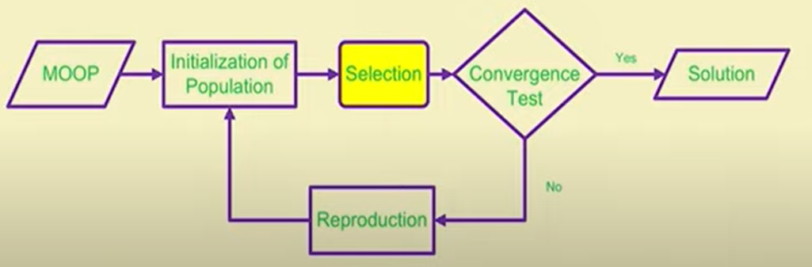
Multi-Objective Evolutionary Algorithms (MOEA)
The diagram shows an MOEA framework, where Reproduction is same as GA, but different strategy is followed in Selection

Slide 3
Difference between GA and MOEA
Single Objective for GA, whereas Multiple Objectives for MOEA
Single Solution for GA, whereas Multiple Trade-Off Solutions for MOEA
Two major problems handled in GAs:
How to accomplish fitness assignment (evaluation) and subsequently selection in order to guide the search towards the Pareto-Optimal set?
How to maintain diverse population in order to prevent premature convergence and achieve a well-distributed Pareto-Optimal front?

Slide 4
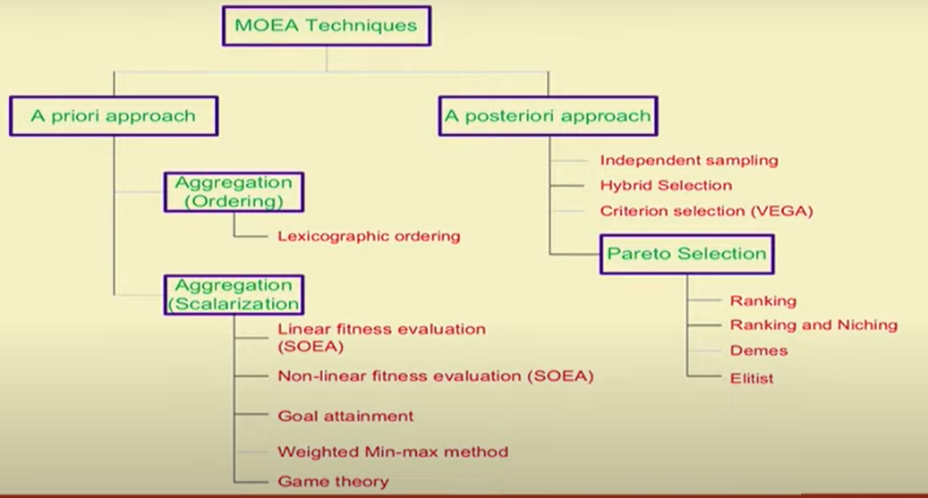
Classification of MOEA Techniques

Slide 5
A priori vs A posteriori
A priori technique requires higher-level knowledge to define the relative importance of the objectives prior to the search
A posteriori technique searches for the Pareto-Optimal solutions from the set of feasible solutions
We will discuss a few MOOP techniques that falls under each of the following categories:
Non-Pareto-Based: Techniques that provide one solution only
Pareto-based: Techniques that provide trade-off solutions

Slide 6
MOEA Techniques To be Discussed
Non-Pareto-Based Approaches
Lexicographic Ordering
Simple Weighted Approach (SOEA)
Criterion Selection (VEGA)
Pareto-Based Approaches
Rank-based Approach (MOGA)
Rank + Niche-Based Approach (NPGA)
Non-dominated Sorting-Based Approach (NSGA)
Elitist Non-dominated Sorting-Based Approach (NSGA-II)

Slide 7
Lexicographic Ordering
Fourman, Michael P. "Compaction of symbolic layout using genetic algorithms." In Proceedings of the 1st international conference on genetic algorithms, pp. 141-153. 1985.
It is an a priori (preference-based) technique based on principle of “aggregation with ordering”

Slide 8
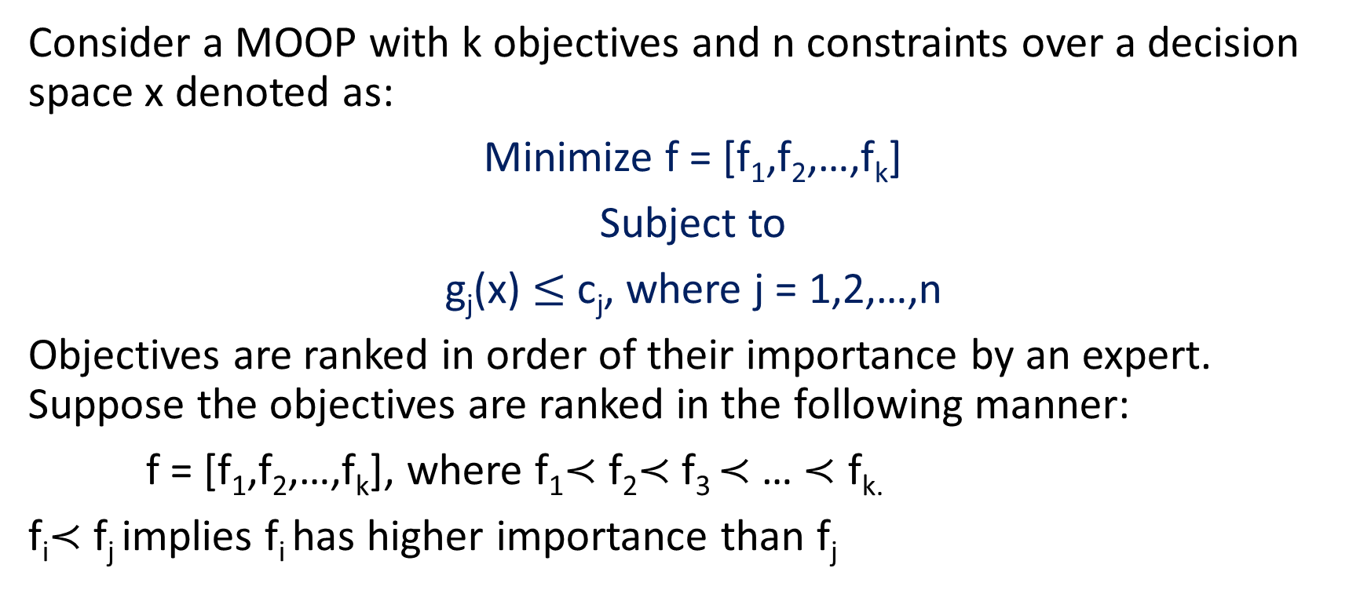
Lexicographic Ordering
Consider a MOOP with k objectives and n constraints over a decision space x denoted as:
Minimize f = [f₁,f₂,…,f_{k}]
Subject to
g_{j}(x) $≤$ c_{j}, where j = 1,2,…,n
Objectives are ranked in order of their importance by an expert. Suppose the objectives are ranked in the following manner:
f = [f₁,f₂,…,f_{k}], where f₁$≺$ f₂$≺$ f₃ $≺$… $≺$ f_{k.}
f_{i}$≺$ f_{j} implies f_{i} has higher importance than f_{j}

Slide 9
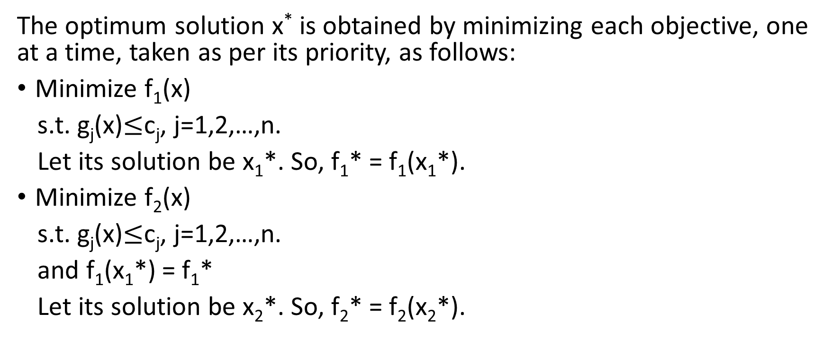
Lexicographic Ordering
The optimum solution x* is obtained by minimizing each objective, one at a time, taken as per its priority, as follows:
Minimize f₁(x)
s.t. g_{j}(x)$≤$c_{j}, j=1,2,…,n.
Let its solution be x₁*. So, f₁* = f₁(x₁*).
Minimize f₂(x)
s.t. g_{j}(x)$≤$c_{j}, j=1,2,…,n.
and f₁(x₁*) = f₁*
Let its solution be x₂*. So, f₂* = f₂(x₂*).

Slide 10
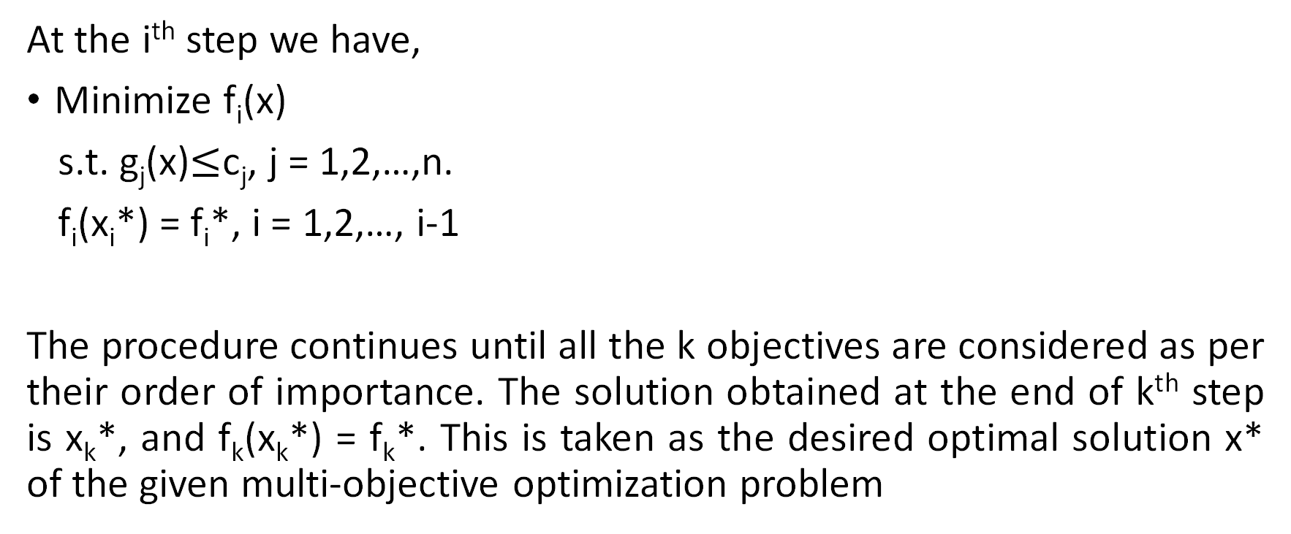
Lexicographic Ordering
At the i^{th} step we have,
Minimize f_{i}(x)
s.t. g_{j}(x)$≤$c_{j}, j = 1,2,…,n.
f_{i}(x_{i}*) = f_{i}*, i = 1,2,…, i-1
The procedure continues until all the k objectives are considered as per their order of importance. The solution obtained at the end of k^{th} step is x_{k}*, and f_{k}(x_{k}*) = f_{k}*. This is taken as the desired optimal solution x* of the given multi-objective optimization problem

Slide 11
A Few Remarks on the Lexicographic Ordering
Deciding priorities of the objective functions is an important issue. Solution may vary if a different order of importance is considered.
Different strategies may be taken to address the above issues.
Random selection of an objective function at each run
Try k! number of orderings of the objective functions and then select the best observed result.
Note that, a single solution is produced finally, rather than Pareto-Optimal solutions.
Hence, lexicographic ordering is an a priori non-pareto-based approach to solve Multi-Objective Optimization problems

Slide 12
Single-Objective Evolutionary Algorithm
This is a priori technique based on the principle of “linear aggregation of functions”
Alternatively, termed as “SOEA” or “Weighted Sum Approach”
Naïve approach to solve MOOP
Approach is to add all the objective functions together using different weight coefficients for each objective, thereby transforming the multi-objective optimization problem into a single-objective optimization problem

Slide 13
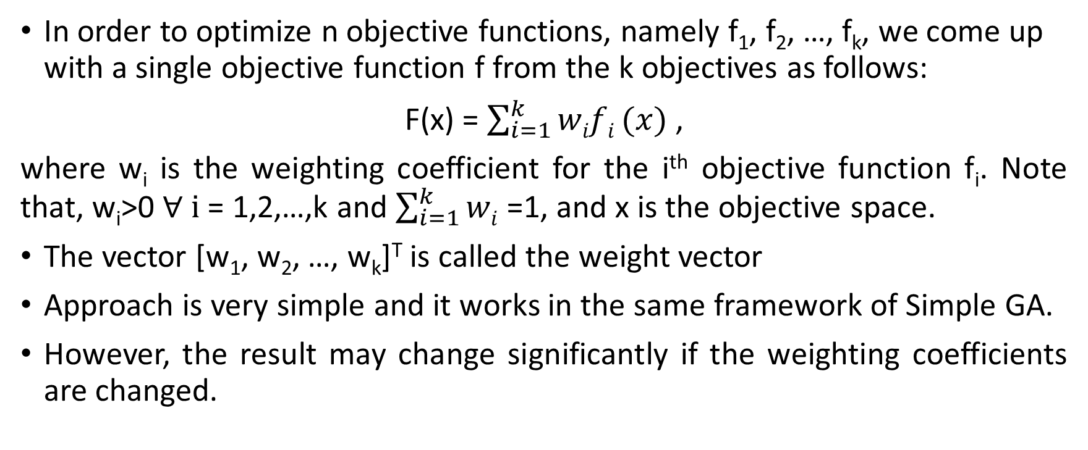
Single-Objective Evolutionary Algorithm
In order to optimize n objective functions, namely f₁, f₂, …, f_{k}, we come up with a single objective function f from the k objectives as follows:
F(x) = $\sum_{i=1}^{k}{wifi}(x)$ ,
where w_{i} is the weighting coefficient for the i^{th} objective function f_{i}. Note that, w_{i}>0 $∀ i$ = 1,2,…,k and $\sum_{i=1}^{k}{wi}$ =1, and x is the objective space.
The vector [w₁, w₂, …, w_{k}]^{T} is called the weight vector
Approach is very simple and it works in the same framework of Simple GA.
However, the result may change significantly if the weighting coefficients are changed.

Slide 14
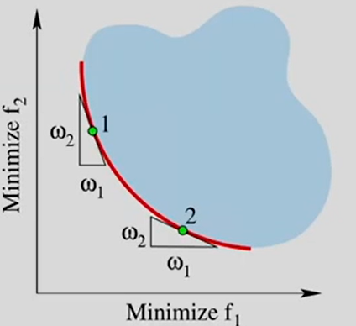
Single-Objective Evolutionary Algorithm
Note that, different combinations of w₁ and w₂ define different directions in order to bias the search.
Different sets of weights may be used to obtain diverse points on the Pareto-front

Slide 15
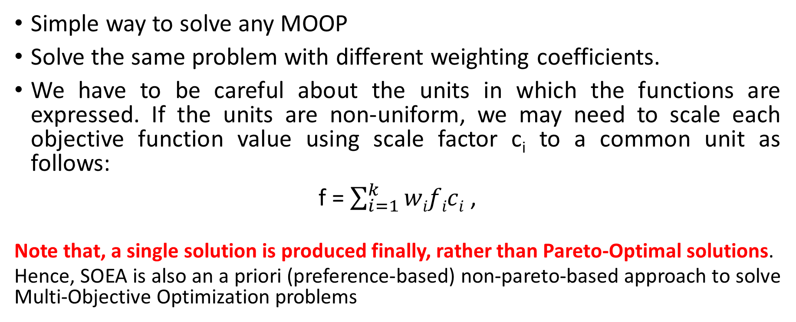
A Few Remarks on SOEA
Simple way to solve any MOOP
Solve the same problem with different weighting coefficients.
We have to be careful about the units in which the functions are expressed. If the units are non-uniform, we may need to scale each objective function value using scale factor c_{i} to a common unit as follows:
f = $\sum_{i=1}^{k}{wifici}$ ,
Note that, a single solution is produced finally, rather than Pareto-Optimal solutions.
Hence, SOEA is also an a priori (preference-based) non-pareto-based approach to solve Multi-Objective Optimization problems

Slide 16
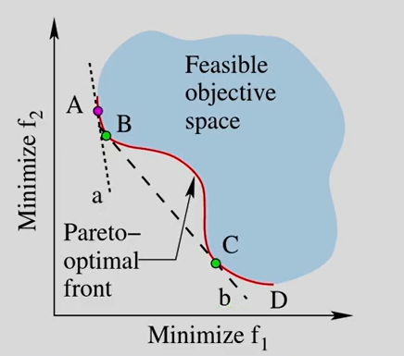
A Few Remarks on SOEA
For problems having convex Pareto Optimal front, this method guarantees generating solutions in the entire pareto-optimal range.
Drawbacks
Different weights do not ensure that we always get different Pareto-Optimal solutions. Multiple weight vectors may result in the same solution.
Well-distributed set of solutions on the Pareto-Optimal front is not guaranteed.
Cannot generate certain Pareto-Optimal solutions in the case of Non-Convex objective space (See figure)

Slide 17
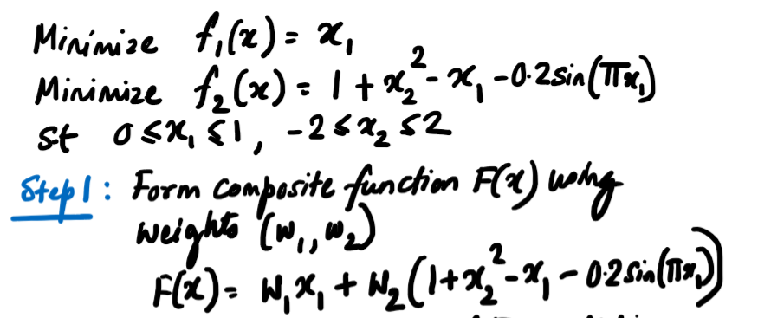
Example

Slide 18
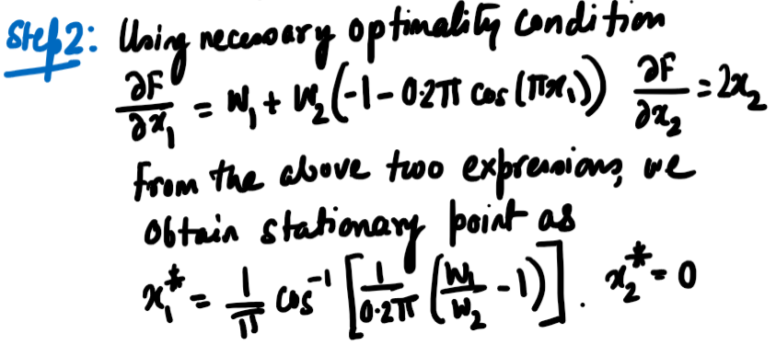
Example

Slide 19
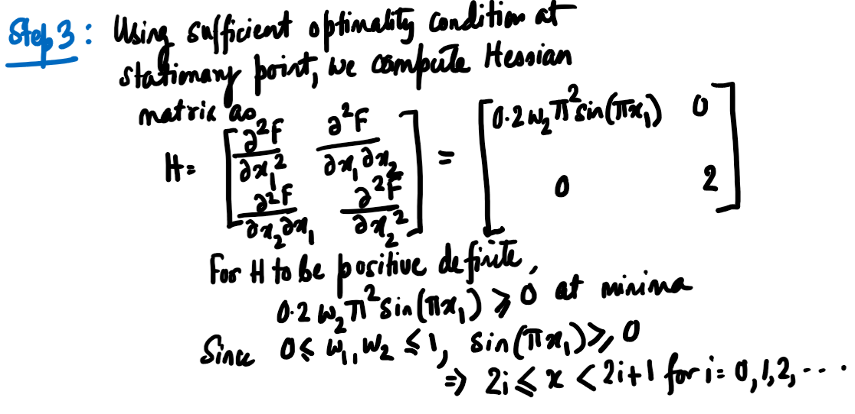
Example

Slide 20
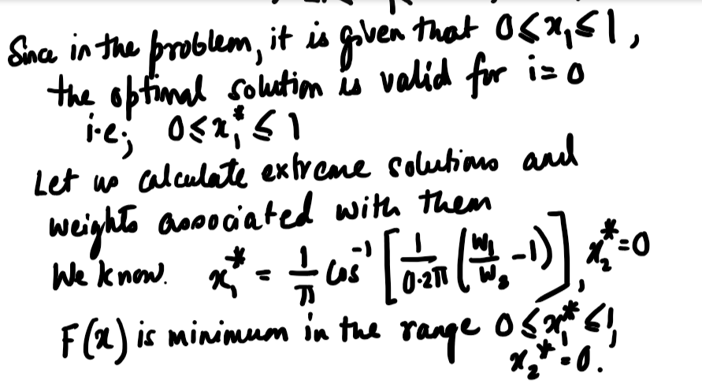
Example

Slide 21
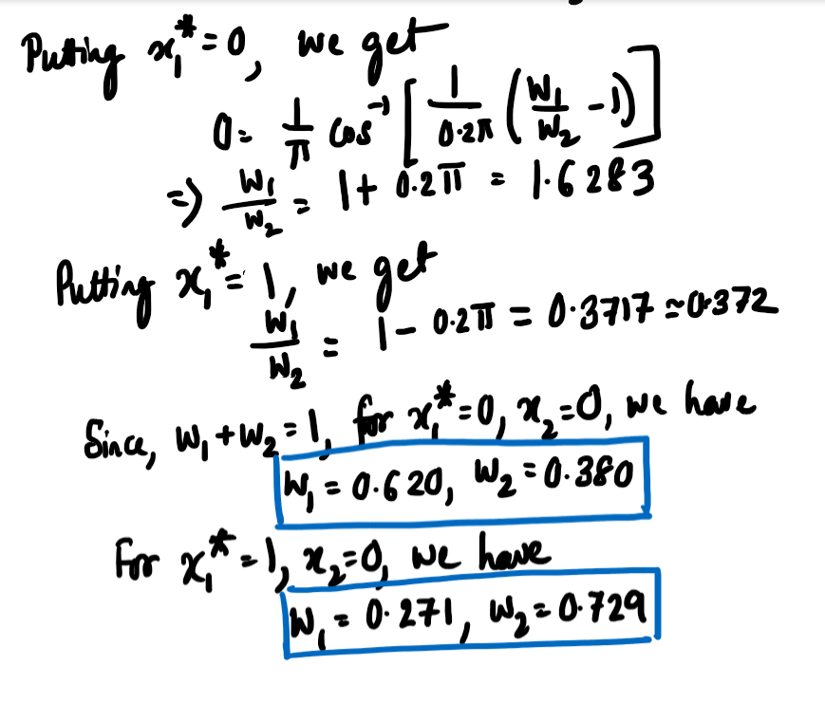
Example

Slide 22
Example
If we choose any combination of weights in the range 0.271 $≤$w₁ $≤$0.620, we get the corresponding optimal solution. Note, w₂ = 1-w₁

Slide 23
Vector Evaluated Genetic Algorithm (VEGA)
Schaffer, J. David. "Multiple objective optimization with vector evaluated genetic algorithms." Proceedings of the first international conference on genetic algorithms and their applications, 1985. Lawrence Erlbaum Associates. Inc., Publishers, 1985.
It is also considered as the first solution to the MOEA
VEGA is a posteriori technique based on the concept of Criterion Selection strategy
It is an extension of SGA

Slide 24
Vector Evaluated Genetic Algorithm (VEGA)
It is an example of Criterion (or Objective) selection technique in which a fraction of each succeeding population is selected based on separate objective performance. The separate objective for each fraction are randomly selected at each generation.
VEGA differs from SGA in the way in which the selection operation is performed.

Slide 25
VEGA: Steps
Suppose, we have k objective functions f₁, f₂, f₃, …, f_{k}.
k sub-populations are created randomly, one for each objective function. Each sub-population can have the same number of individuals.
For each objective, we should have some population in the mating pool.
If M is the size of the mating pool, we select M/k individuals from each sub-population based on the fitness value using any proportionate selection scheme.
The selected individuals for all the sub-populations in the mating pool are shuffled together to obtain a new ordering.
Apply standard GA operations related to reproduction.
This produces the next generation and Steps 2-6 are continued until the termination condition is reached.

Slide 26

VEGA: Creating of Sub-populations
Create a mating pool of size M (M$≤$N)
Generate i^{th} population of size M/k where i = 1,2,…,k. To do this, follow the proportional selection strategy (such as Roulette-wheel selection) according to the i^{th} objective function only at a time

Slide 27
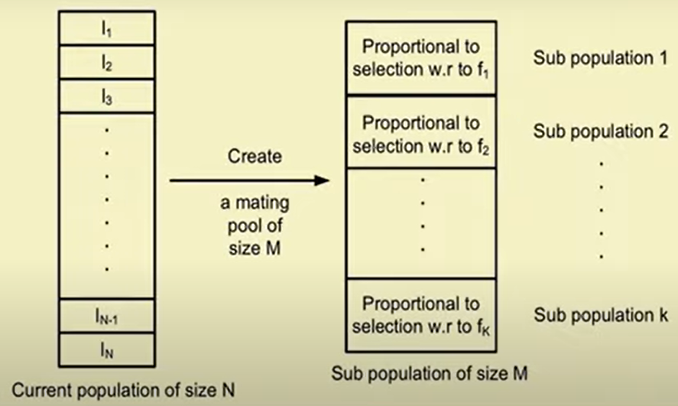
VEGA: Creating of Sub-populations

Slide 28
VEGA: Shuffle the Sub-Populations
Use some shuffling operation
Example:
Generate two random numbers i and j between 1 and k, and then swap any two individuals between the two sub-populations i and j.
Shuffling can be done any number of times

Slide 29
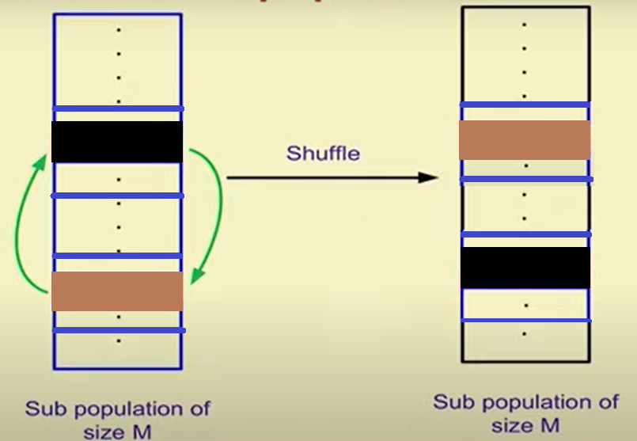
VEGA: Shuffle the Sub-Populations
Sub-population i
Sub-population j

Slide 30
VEGA: Reproduction
Perform crossover and mutation on the combined mating pool using the same technique as we studied in Genetic Algorithm.
According to Schaffer, a crossover between too good solutions, each corresponding to a different objective, may find offspring which are good compromised solutions between the two objectives.

Slide 31
Comments on VEGA
VEGA can be implemented in the same framework as SGA (only with a modification of the selection operation)
It can be viewed as simultaneously optimizing the k objectives, i.e.,
F(x) = Ê₁f₁(x) + Ê₂f₂(x) + …+ Ê_{k}f_{k}(x), where Ê_{k} is the k^{th} vector.
Thus, VEGA is a generalization from scalar genetic algorithm to vector-evaluated genetic algorithm.
VEGA leads to solutions close to local optima with regard to each individual objective

Slide 32
Vector Evaluated Genetic Algorithm (VEGA)
Advantage: The main advantage of a VEGA is that it uses a simple idea and is easy to implement. Only minor changes are required to be made in a simple GA to convert it to a multi-objective GA and this does not incur any additional computational complexity..
Disadvantage: Since each solution in a VEGA is evaluated only with one objective function, every solution is not tested for other (k-1) objective functions, all of which are also important in the context of multi-objective optimization. During a simulation run of a VEGA, it is likely that solutions near the optimum of an individual objective function would be preferred by the selection operator in a sub-population. Such preference takes place in parallel with other objective functions in different sub-populations.

Slide 33
Vector Evaluated Genetic Algorithm (VEGA)
The solutions generated by VEGA are locally dominated but not necessarily globally dominated
VEGA selects individuals that excel in one objective, without looking at the others

